Slide 1


Visualization
- Endangered and Extinct Species (Challenge A, B) -
Natalia Aponte – CID: 01299891
Nontharatt Jarnyaharn – CID: 01403667
Qi Tang – CID: 00864393
Seongmin Lee – CID: 01247436

Slide 2

Table of Contents
1
Stage1 : Formulating the brief
2
Stage2 : Working with Data
3
Stage3 : Editorial Thinking
4
Stage4: Design Solution

Slide 3
STAGE① : Curiosity
Topline Questions
What can we do for endangered animals?
2. As an audience, how can I contribute?
3. What impact can I have for threatened animals species?

Slide 4


STAGE① : Circumstances
[Guardian]
[IUCN]
Social matters
(not same old story,
but something new)
Stakeholder
General Information
(Cover From Abstract to Discrete)
Upper-mid Class
Social responsibility
(not same old story)
Audience
Research, advocacy,
Education, Lobbyist
Setting
During commute
→ Cannot focus a lot
During working hours
→ Scrutinize

Slide 5
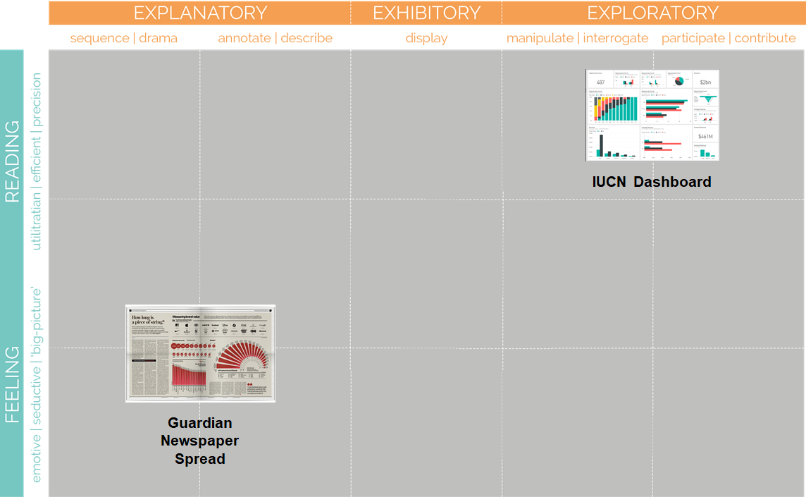
STAGE① : Purpose map

Slide 6






STAGE② : Data Cleaning
Curiosity
Questions
Working with Data
Preprocessing
Data Analysis
Table
1, 2, 3, 4, 5, 6
Missing Value
Tidy Data
Merge
Time series
Geographic
Cross-sectional
GDP, IUCN, CO2

Slide 7
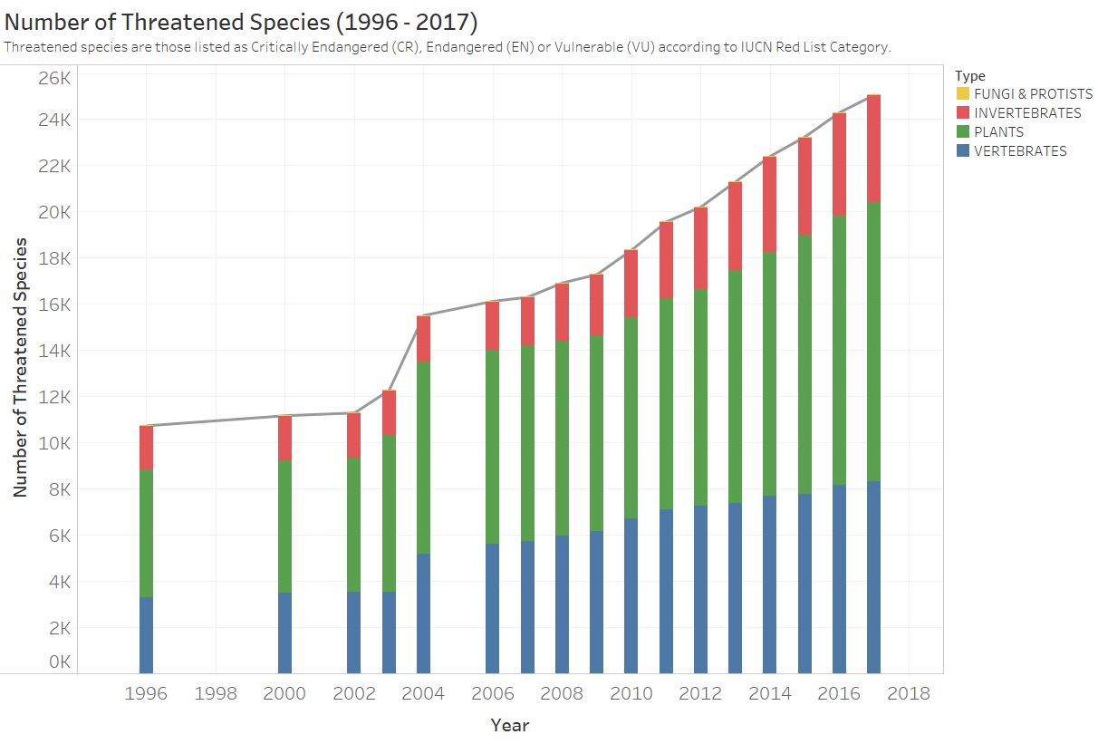
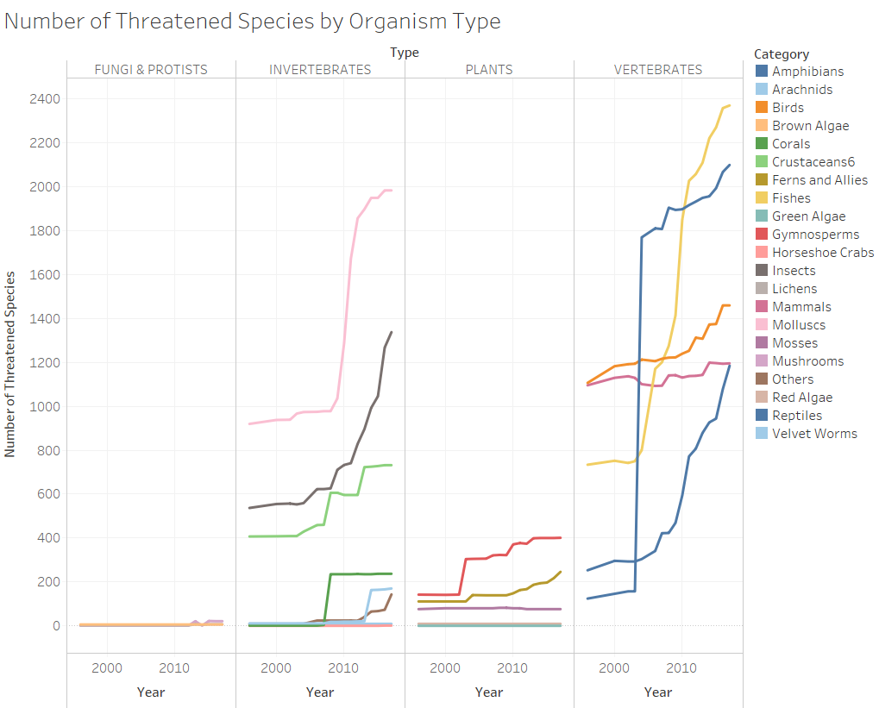
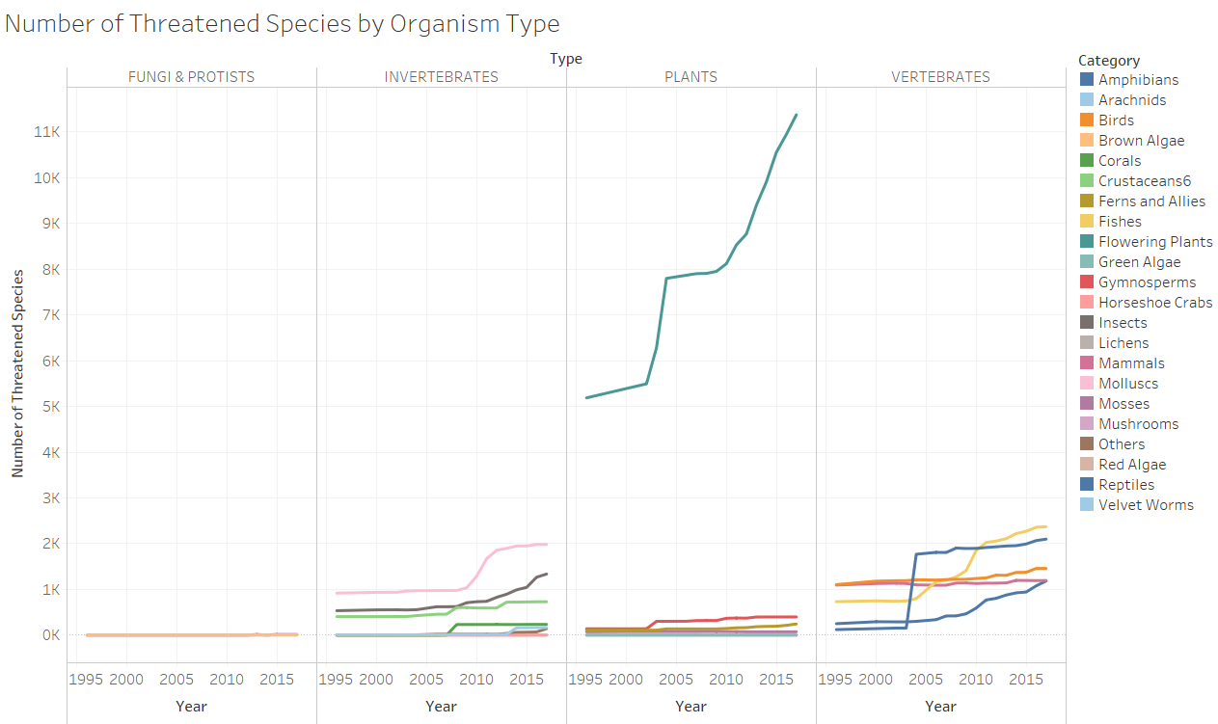

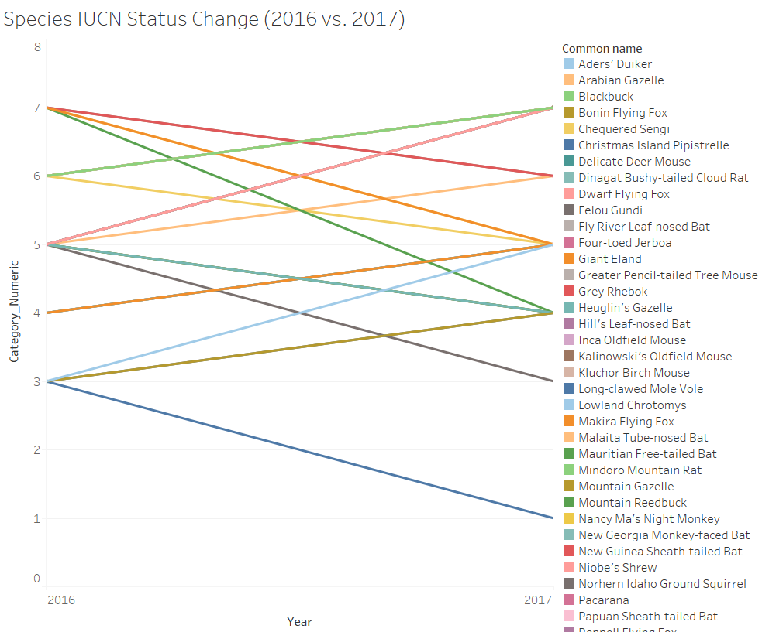
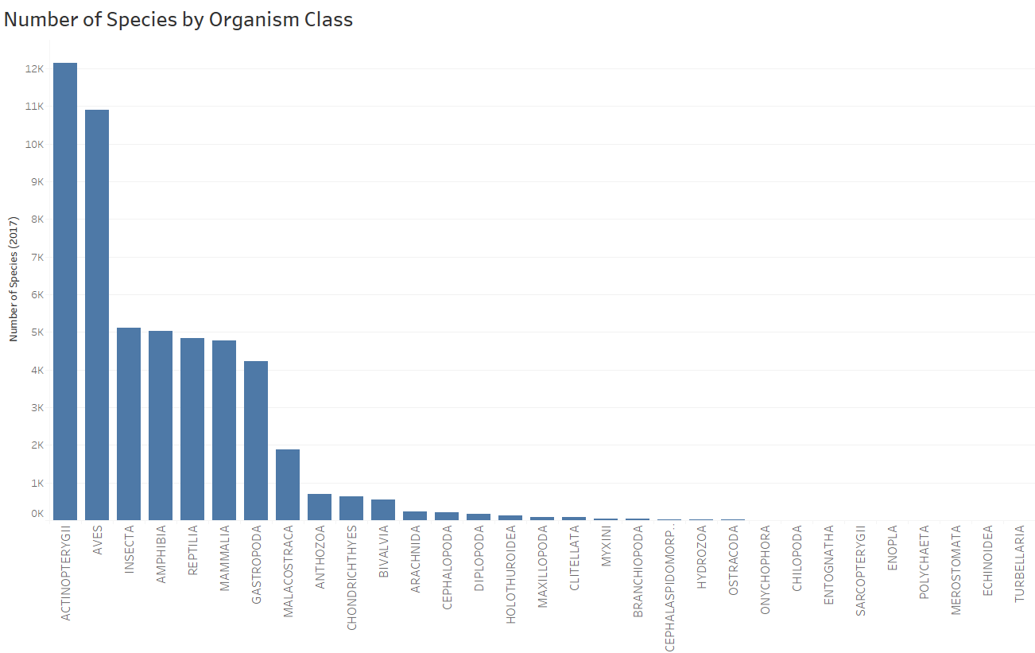
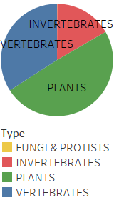
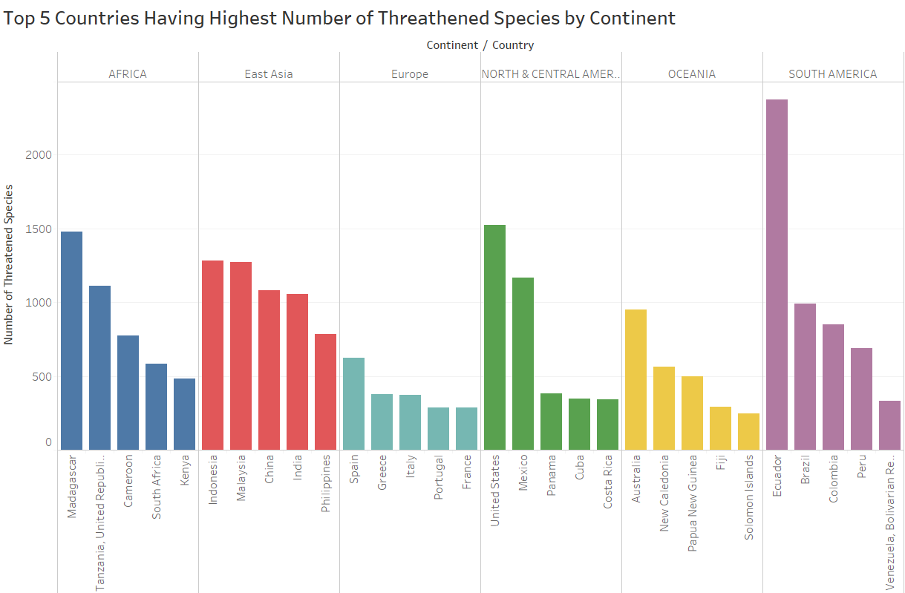
STAGE② : Data Analysis
Time Series
Cross-Sectional
- Which analysis is more effective
for each media
- What dataset is more informative
- Any result that we didn’t expect
Spatial

Slide 8
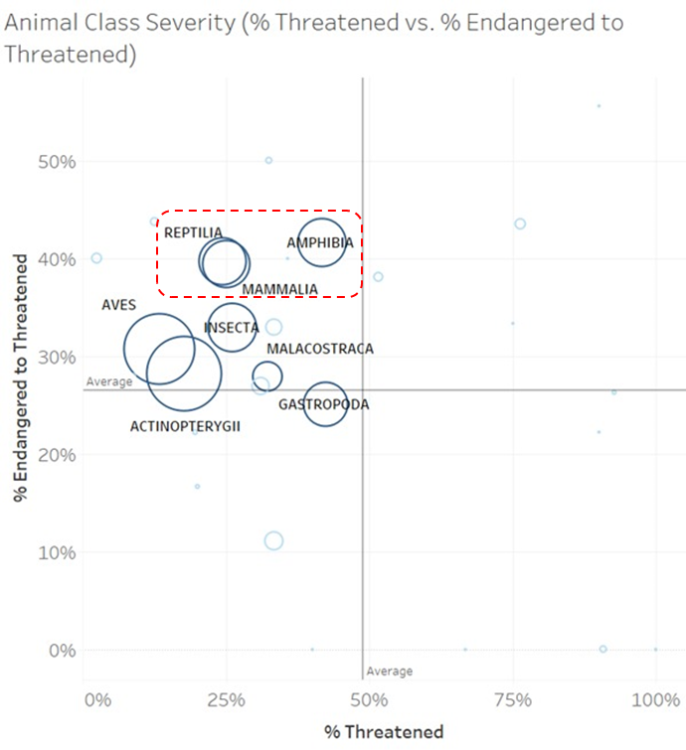
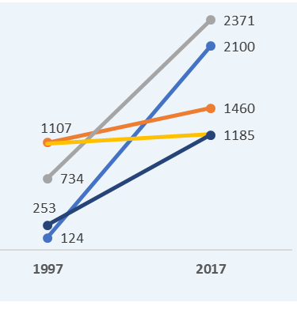


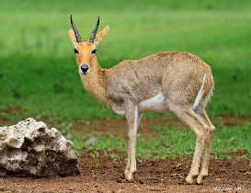
STAGE③ : Editorial Thinking
Curiosity : What taxonomy or animal is the most jeopardized?
Which
Where
When
What
Source: Table3
Source: Table5/6
Source: Table1/2
Source: Table7
Angle: Which taxonomy
Angle: what country for
each continent
Angle: Different between
present vs. past
Angle: Particular Animal for
an good example
Focus: Portion
Focus: Top 5
Focus: 1997 vs. 2017
Focus: Mountain Reedbuck
[Mountain Reedbuck]

Slide 9
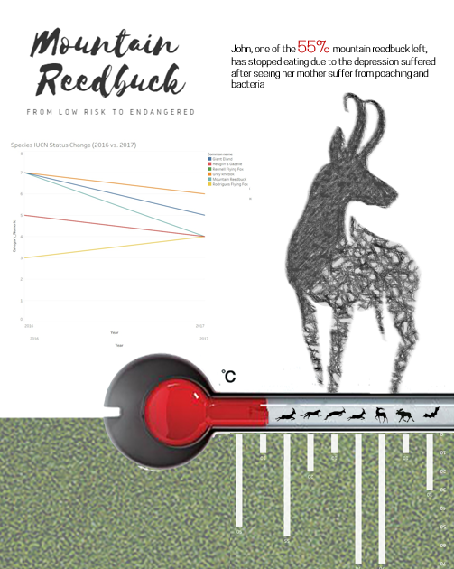
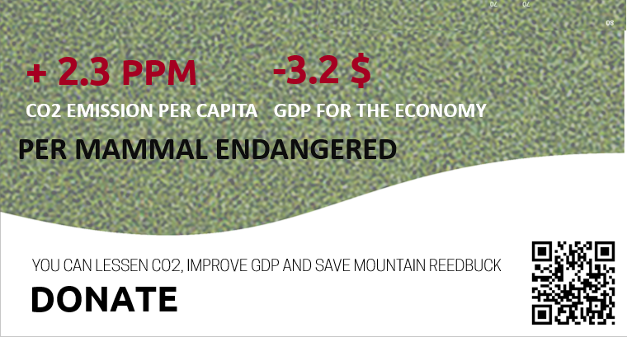
STAGE④ : Design Solution (Spread)

Slide 10
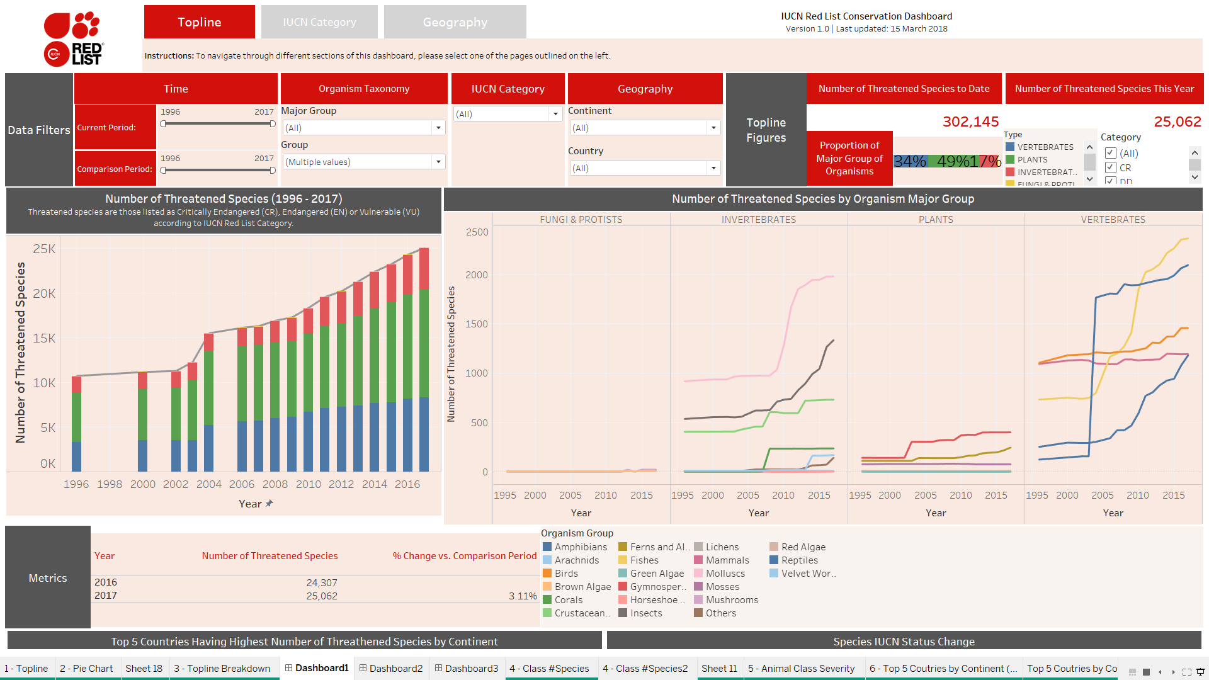
STAGE④ : Design Solution(Dashboard)

Slide 11
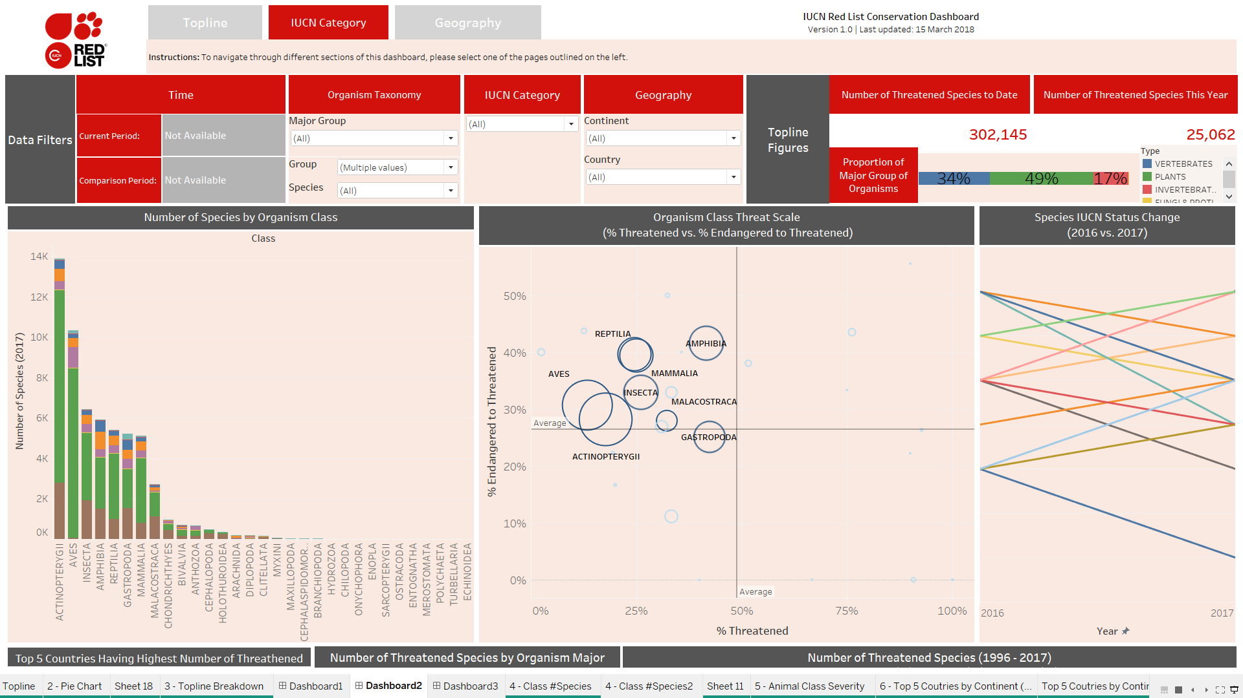
STAGE④ : Design Solution(Dashboard)

Slide 12
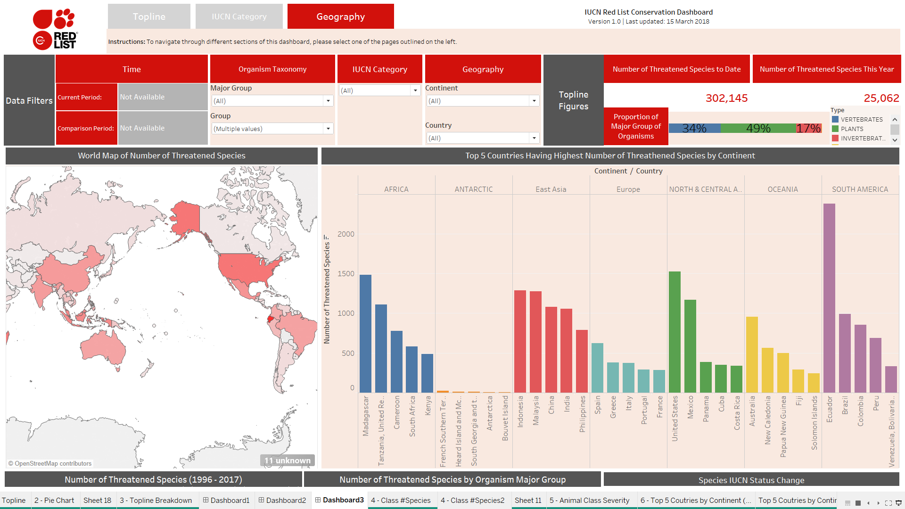
STAGE④ : Design Solution(Dashboard)

Slide 13


